Slide 1
CS101 Algorithms and Data Structures
Greedy Algorithm
Algorithm Design Ch 4.1 4.2
Notes:
Adapted from the Lecture slides by Kevin Wayne at http://www.cs.princeton.edu/~wayne/kleinberg-tardos
May also contain material from the slides at https://ece.uwaterloo.ca/~dwharder/aads/Lecture_materials/ (by Dan Suciu of U Washington)

Slide 2

Uniqueness of Minimum Spanning Trees
Lemma. If all edge weights in a connected graph $G$ are distinct, then $G$
has a unique minimum spanning tree.

Slide 3

Uniqueness of Minimum Spanning Trees
Lemma. If all edge weights in a connected graph $G$ are distinct, then $G$
has a unique minimum spanning tree.
Proof. Greedy exchange argument → Contradiction

Slide 4
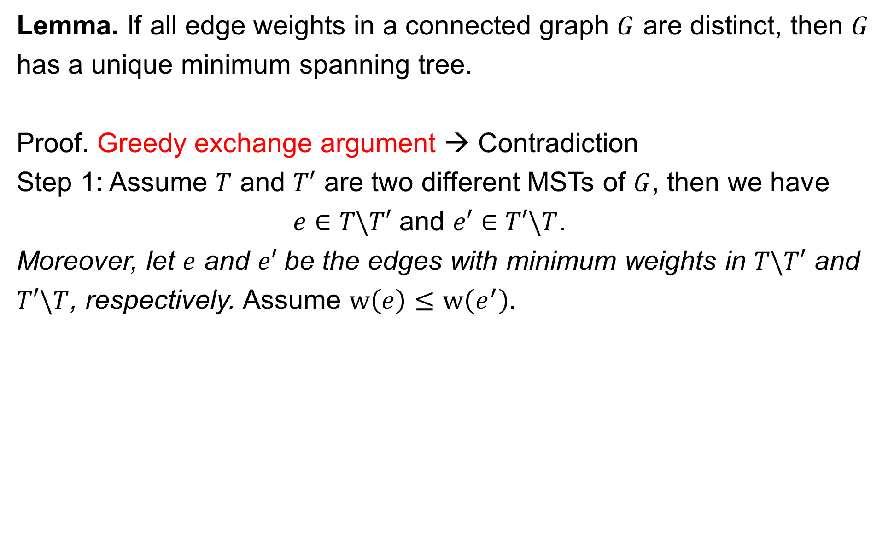
Uniqueness of Minimum Spanning Trees
Lemma. If all edge weights in a connected graph $G$ are distinct, then $G$
has a unique minimum spanning tree.
Proof. Greedy exchange argument → Contradiction
Step 1: Assume $T$ and $T′$ are two different MSTs of $G$, then we have
$e∈T\backslash T′$ and $e′∈T′\backslash T$.
Moreover, let $e$ and $e′$be the edges with minimum weights in $T\backslash T′$ and
$T′\backslash T$, respectively. Assume $w\left(e\right)≤w\left(e^{′}\right).$

Slide 5
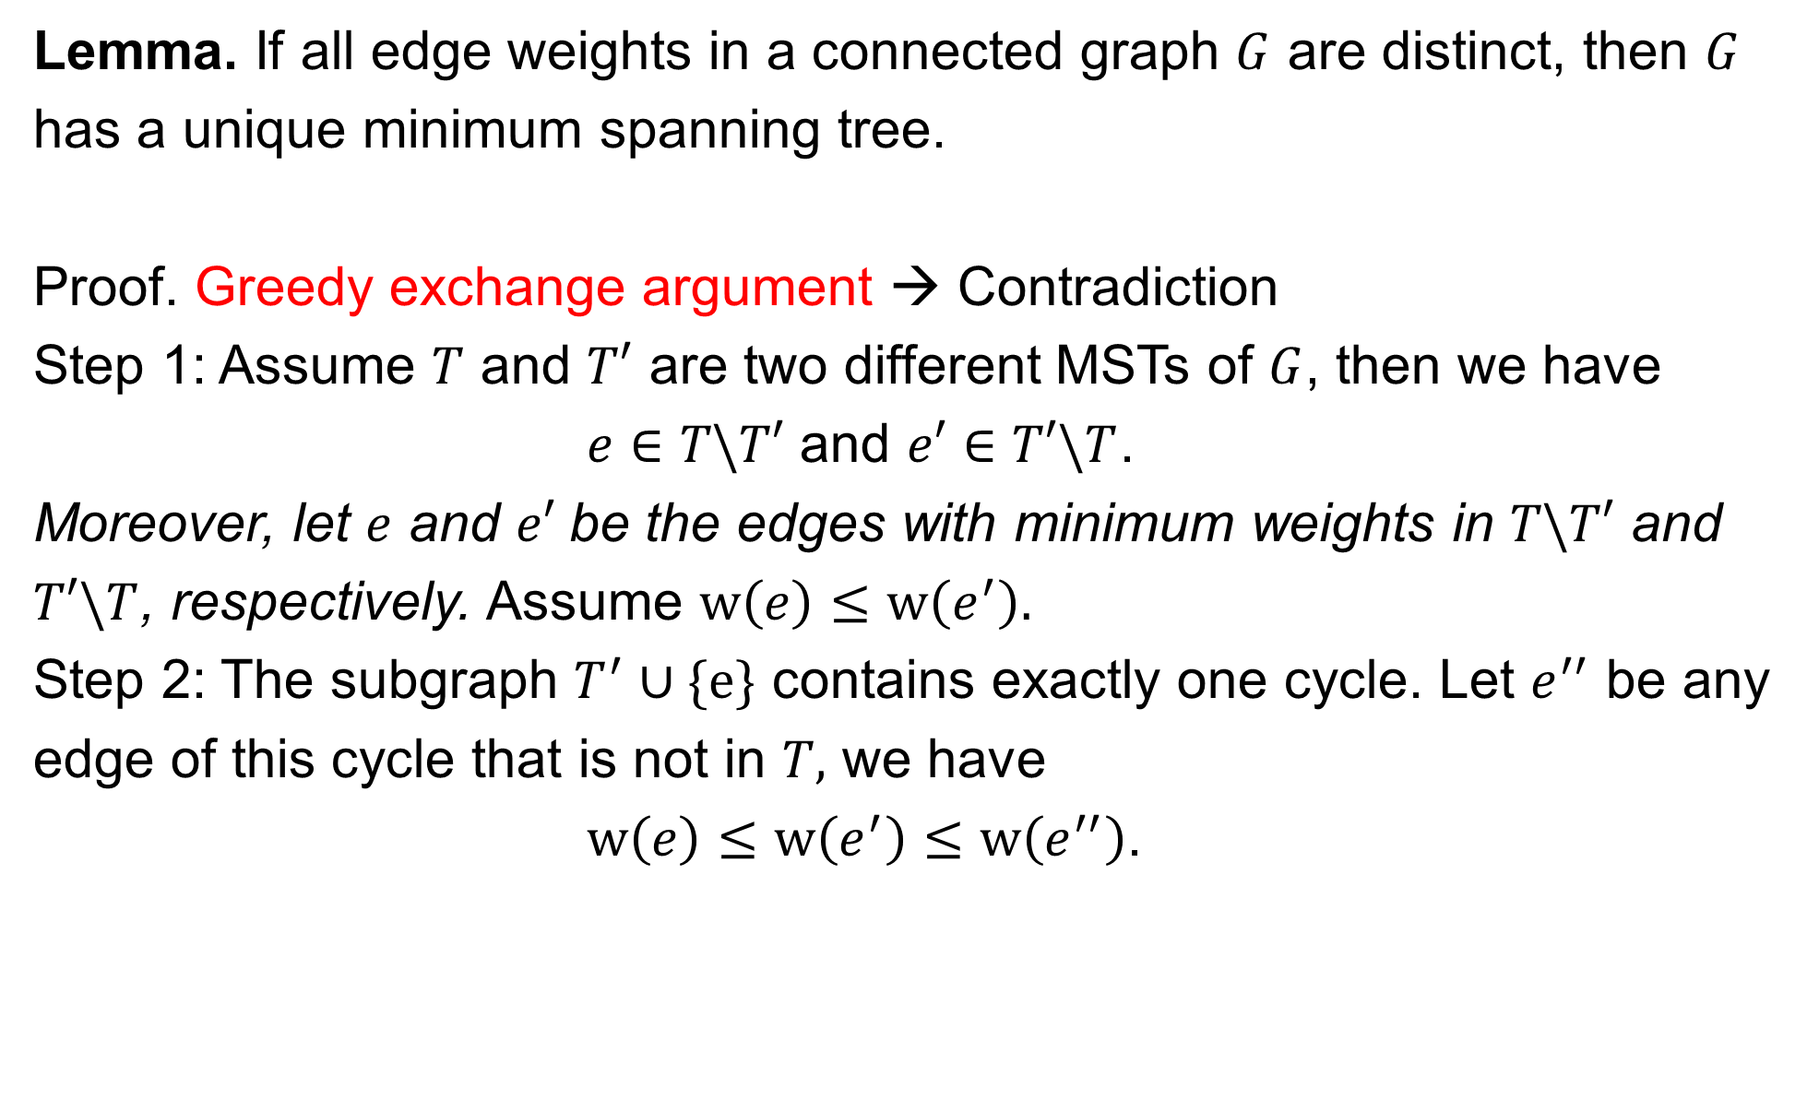
Uniqueness of Minimum Spanning Trees
Lemma. If all edge weights in a connected graph $G$ are distinct, then $G$
has a unique minimum spanning tree.
Proof. Greedy exchange argument → Contradiction
Step 1: Assume $T$ and $T′$ are two different MSTs of $G$, then we have
$e∈T\backslash T′$ and $e′∈T′\backslash T$.
Moreover, let $e$ and $e′$be the edges with minimum weights in $T\backslash T′$ and
$T′\backslash T$, respectively. Assume $w\left(e\right)≤w\left(e^{′}\right).$
Step 2: The subgraph $T^{′}∪\{e\}$ contains exactly one cycle. Let $e^{′′}$ be any
edge of this cycle that is not in $T,$ we have
$w\left(e\right)≤w\left(e^{′}\right)≤w\left(e^{′′}\right)$.

Slide 6
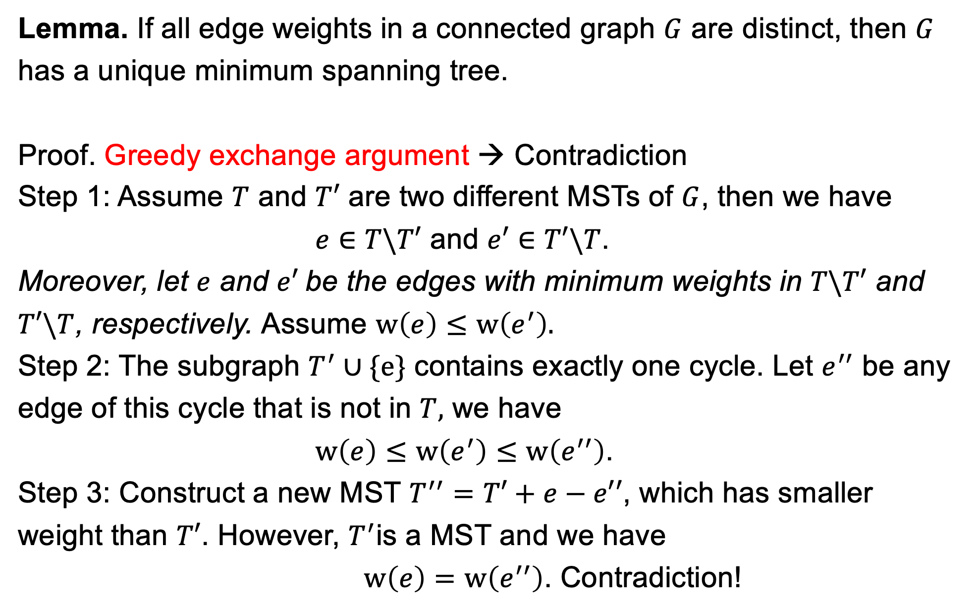
Uniqueness of Minimum Spanning Trees
Lemma. If all edge weights in a connected graph $G$ are distinct, then $G$
has a unique minimum spanning tree.
Proof. Greedy exchange argument → Contradiction
Step 1: Assume $T$ and $T′$ are two different MSTs of $G$, then we have
$e∈T\backslash T′$ and $e′∈T′\backslash T$.
Moreover, let $e$ and $e′$be the edges with minimum weights in $T\backslash T′$ and
$T′\backslash T$, respectively. Assume $w\left(e\right)≤w\left(e^{′}\right).$
Step 2: The subgraph $T^{′}∪\{e\}$ contains exactly one cycle. Let $e^{′′}$ be any
edge of this cycle that is not in $T,$ we have
$w\left(e\right)≤w\left(e^{′}\right)≤w\left(e^{′′}\right)$.
Step 3: Construct a new MST $T^{′′}=T′+e−e′′$, which has smaller
weight than $T′$. However, $T^{′}$is a MST and we have
$w\left(e\right)=w\left(e^{′′}\right)$. Contradiction!

Slide 7
Greedy algorithms
Suppose it is possible to build a solution through a sequence of partial solutions
At each step, we focus on one particular partial solution and we attempt to extend that solution
Ultimately, the partial solutions should lead to a feasible solution which is also optimal
Greedy exchange argument
Modify a solution incrementally by any other algorithm into the solution by your greedy algorithm
Justify the modification doesn’t make the solution worsen.
Your solution is at least as good as that of any other solution (optimal solution).
Notes:
7

Slide 8
Outline
Coin changing
Interval scheduling
Interval partitioning
Scheduling to minimize lateness
Optimal caching

Slide 9








Making change
Consider this commonplace example:
Making the exact change with the minimum number of coins
Consider the Euro denominations of 1, 2, 5, 10, 20, 50 cents
Stating with an empty set of coins, add the largest coin possible into the set which does not go over the required amount
Notes:
9

Slide 10
Making change
Total €0.50
To make change for €0.72:
Start with €0.50
Notes:
10

Slide 11
Making change
Total €0.70
To make change for €0.72:
Start with €0.50
Add a €0.20
Notes:
11

Slide 12
Making change
Total €0.72
To make change for €0.74:
Start with €0.50
Add a €0.20
Skip the €0.10 and the €0. 05 but add a €0.02
Notes:
12

Slide 13
Making change
Notice that each digit can be worked with separately
The maximum number of coins for any digit is three
Thus, to make change for anything less than €1 requires at most six coins
The solution is optimal
Notes:
13

Slide 14



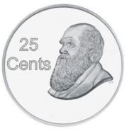



Making change
Reference: J.K. Rowlings, Harry Potter, Raincoast Books, 1997.
Does this strategy always work?
What if our coin denominations grow quadraticly?
Consider 1, 4, 9, 16, 25, 36, and 49 dumbledores

Slide 15
Making change
Using our algorithm, to make change for 72 dumbledores, we require six coins:
72 = 49 + 16 + 4 + 1 + 1 + 1

Slide 16
Making change
The optimal solution, however, is two 36 dumbledore coins

Slide 17
Definition
A greedy algorithm is an algorithm which has:
A set of partial solutions from which a solution is built
An objective function which assigns a value to any partial solution
Then given a partial solution, we
Consider possible extensions of the partial solution
Discard any extensions which are not feasible
Choose that extension which minimizes the object function
This continues until some criteria has been reached

Slide 18
Optimal example
Prim’s algorithm is a greedy algorithm:
Any connected sub-graph of k vertices and k – 1 edges is a partial solution
The value to any partial solution is the sum of the weights of the edges
Then given a partial solution, we
Add that edge which does not create a cycle in the partial solution and which minimizes the increase in the total weight
We continue building the partial solution until the partial solution has n vertices
An optimal solution is found

Slide 19
Optimal and sub-optimal examples
Our coin change example is greedy:
Any subset of k coins is a partial solution
The value to any partial solution is the sum of the values
Then given a partial solution, we
Add that coin which maximizes the increase in value without going over the target value
We continue building the set of coins until we have reached the target value
An optimal solution is found with euros and cents, but not with our quadratic dumbledore coins

Slide 20
Outline
Coin changing
Interval scheduling
Interval partitioning
Scheduling to minimize lateness
Optimal caching

Slide 21
Interval scheduling
Job j starts at s_{j} and finishes at f_{j}.
Two jobs are compatible if they don’t overlap.
Goal: find maximum subset of mutually compatible jobs.
a
b
b
c
d
e
jobs d and g
are incompatible
e
f
g
h
h
time
0
1
2
3
4
5
6
7
8
9
10
11
Notes:
Activity selection = interval scheduling
OPT = B, E, H
Note: smallest job (C) is not in any optimal solution, job that starts first (A) is not in any optimal solution.

Slide 22
Interval scheduling: greedy algorithms
Greedy template. Consider jobs in some natural order. Take each job provided it′s compatible with the ones already taken.
[Earliest start time] Consider jobs in ascending order of s_{j}.
[Earliest finish time] Consider jobs in ascending order of f_{j}.
[Shortest interval] Consider jobs in ascending order of f_{j} – s_{j}.
[Fewest conflicts] For each job j, count the number of conflicting jobs c_{j}. Schedule in ascending order of c_{j}.

Slide 23
Interval scheduling: greedy algorithms
Greedy template. Consider jobs in some natural order. Take each job provided it′s compatible with the ones already taken.
counterexample for earliest start time
counterexample for shortest interval
counterexample for fewest conflicts

Slide 24
Interval scheduling: earliest-finish-time-first algorithm
Proposition. Can implement earliest-finish-time first in O(n log n) time.
Keep track of job j* that was added last to S.
Job j is compatible with S iff s_{j} ≥ f_{j*} .
Sorting by finish times takes O(n log n) time.
Earliest-Finish-Time-First (n, s1, s2, …, sn , f1, f2, …, fn)
_________________________________________________________________________________________________________________________________________________________________________________________________________________________________________________________________________________________________________________________________________________________________________________________________________________________________________________________________________________________________________________________________________________________________________________________________________________________________________________________________________________________________________________________________________________________________________________________________________________________________________________________________________________________________________________________________________________________________________________________________________________________________________________________________________________________________________________________________________________________________________________
Sort jobs by finish times and renumber so that f1 ≤ f2 ≤ … ≤ fn.
S ← ∅.
For j = 1 to n
If (job j is compatible with S)
S ← S ∪ { j }.
Return S.
_________________________________________________________________________________________________________________________________________________________________________________________________________________________________________________________________________________________________________________________________________________________________________________________________________________________________________________________________________________________________________________________________________________________________________________________________________________________________________________________________________________________________________________________________________________________________________________________________________________________________________________________________________________________________________________________________________________________________________________________________________________________________________________________________________________________________________________________________________________________________________________
set of jobs selected

Slide 25
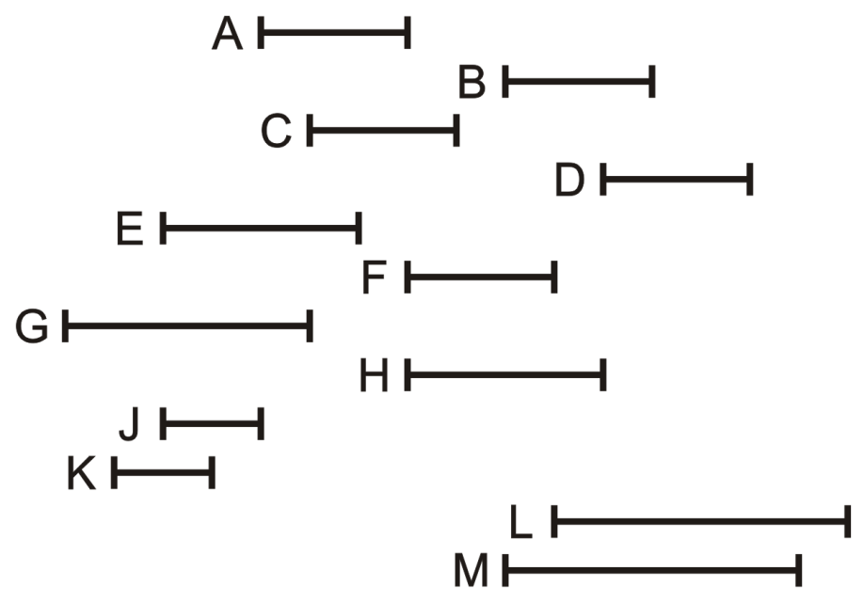
Interval scheduling: Example
Consider the following list of 12 processes together with the time interval during which they must be run
Find the schedule with the earliest- deadline-first greedy algorithm
Process | Interval
A | 5 – 8
B | 10 – 13
C | 6 – 9
D | 12 – 15
E | 3 – 7
F | 8 – 11
G | 1 – 6
H | 8 – 12
J | 3 – 5
K | 2 – 4
L | 11 – 16
M | 10 – 15

Slide 26
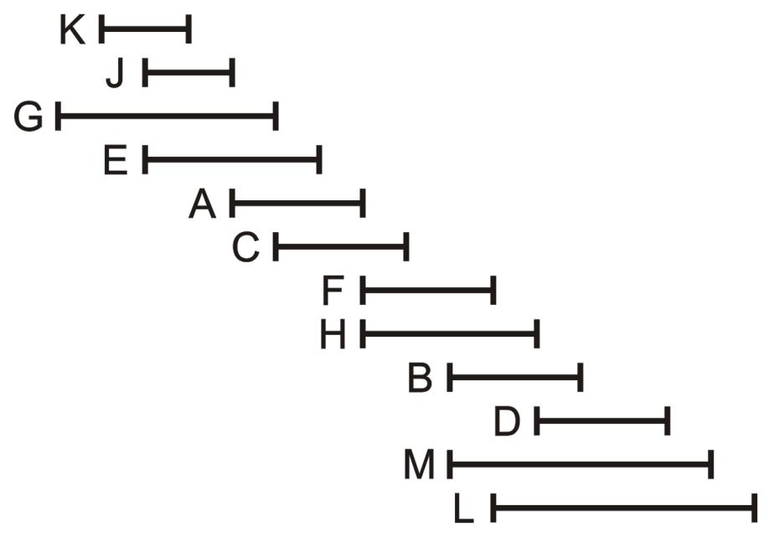
Interval scheduling: Example
In order to simplify this, sort the processes on their end times
Process | Interval
K | 2 – 4
J | 3 – 5
G | 1 – 6
E | 3 – 7
A | 5 – 8
C | 6 – 9
F | 8 – 11
H | 8 – 12
B | 10 – 13
D | 12 – 15
M | 10 – 15
L | 11 – 16

Slide 27
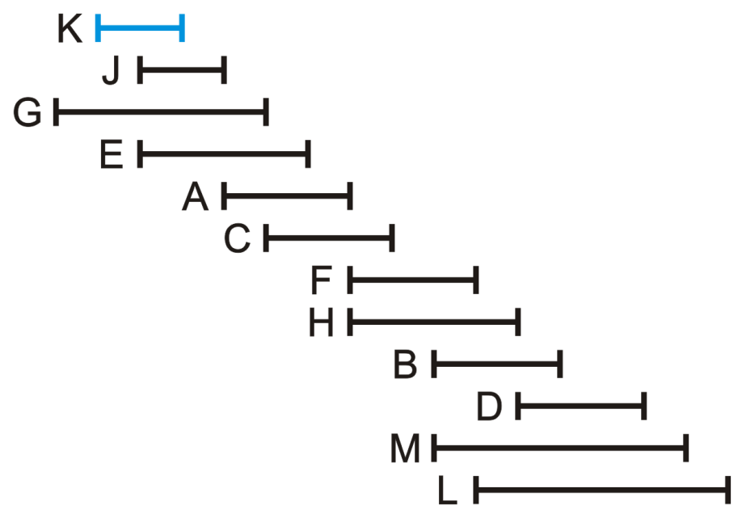
Interval scheduling: Example
To begin, choose Process K
Process | Interval
K | 2 – 4
J | 3 – 5
G | 1 – 6
E | 3 – 7
A | 5 – 8
C | 6 – 9
F | 8 – 11
H | 8 – 12
B | 10 – 13
D | 12 – 15
M | 10 – 15
L | 11 – 16

Slide 28
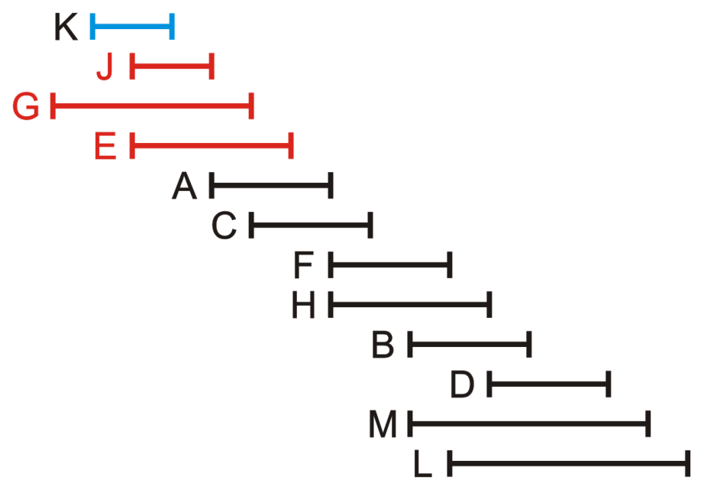
Interval scheduling: Example
At this point, Process J, G and E can no longer be run
Process | Interval
K | 2 – 4
J | 3 – 5
G | 1 – 6
E | 3 – 7
A | 5 – 8
C | 6 – 9
F | 8 – 11
H | 8 – 12
B | 10 – 13
D | 12 – 15
M | 10 – 15
L | 11 – 16

Slide 29
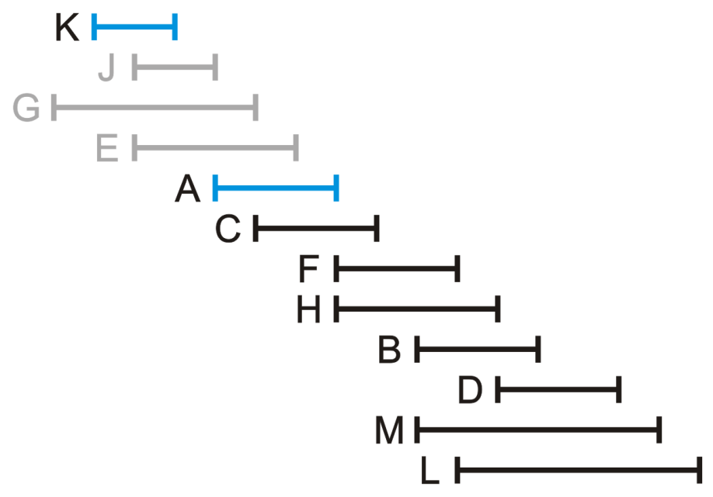
Interval scheduling: Example
Next, run Process A
Process | Interval
K | 2 – 4
J | 3 – 5
G | 1 – 6
E | 3 – 7
A | 5 – 8
C | 6 – 9
F | 8 – 11
H | 8 – 12
B | 10 – 13
D | 12 – 15
M | 10 – 15
L | 11 – 16

Slide 30
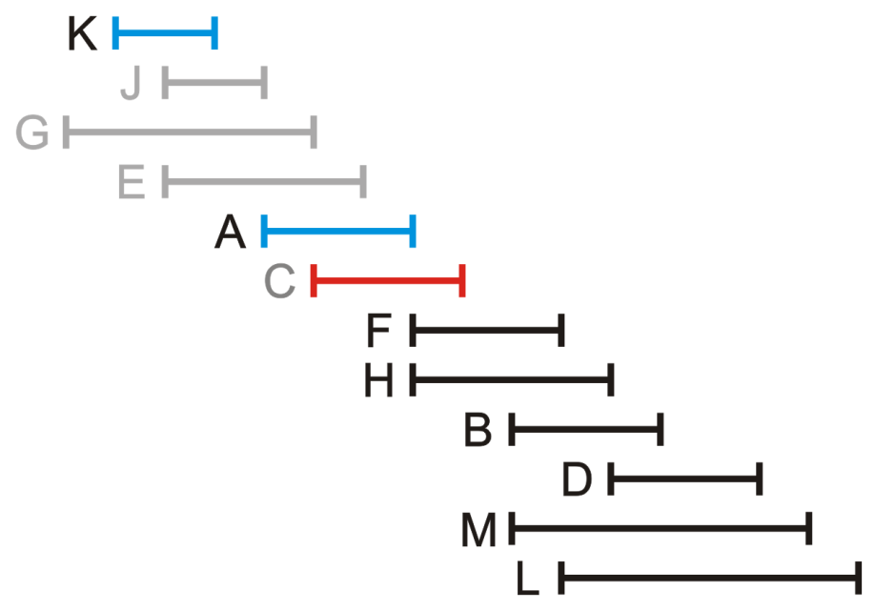
Interval scheduling: Example
We can no longer run Process C
Process | Interval
K | 2 – 4
J | 3 – 5
G | 1 – 6
E | 3 – 7
A | 5 – 8
C | 6 – 9
F | 8 – 11
H | 8 – 12
B | 10 – 13
D | 12 – 15
M | 10 – 15
L | 11 – 16

Slide 31
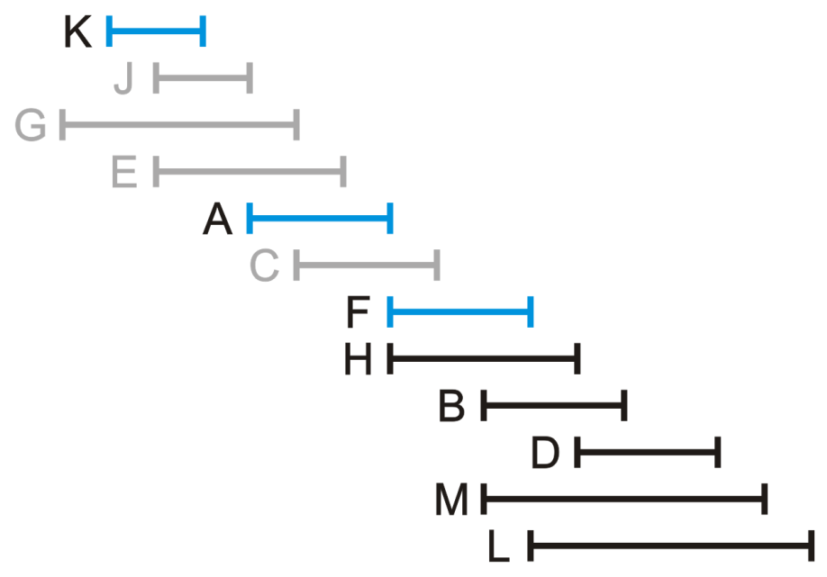
Interval scheduling: Example
Next, we can run Process F
Process | Interval
K | 2 – 4
J | 3 – 5
G | 1 – 6
E | 3 – 7
A | 5 – 8
C | 6 – 9
F | 8 – 11
H | 8 – 12
B | 10 – 13
D | 12 – 15
M | 10 – 15
L | 11 – 16

Slide 32
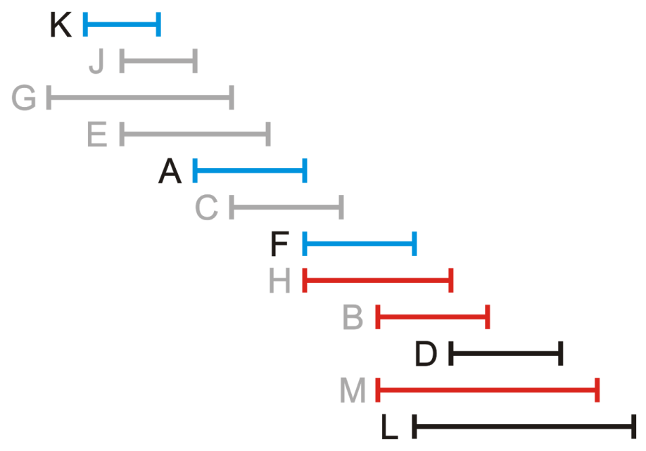
Interval scheduling: Example
This restricts us from running Processes H, B and M
Process | Interval
K | 2 – 4
J | 3 – 5
G | 1 – 6
E | 3 – 7
A | 5 – 8
C | 6 – 9
F | 8 – 11
H | 8 – 12
B | 10 – 13
D | 12 – 15
M | 10 – 15
L | 11 – 16

Slide 33
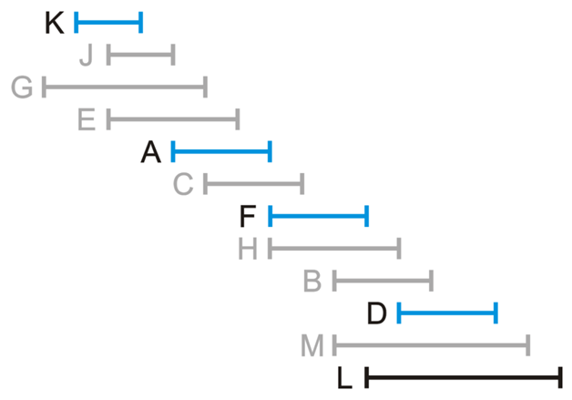
Interval scheduling: Example
The next available process is D
Process | Interval
K | 2 – 4
J | 3 – 5
G | 1 – 6
E | 3 – 7
A | 5 – 8
C | 6 – 9
F | 8 – 11
H | 8 – 12
B | 10 – 13
D | 12 – 15
M | 10 – 15
L | 11 – 16

Slide 34
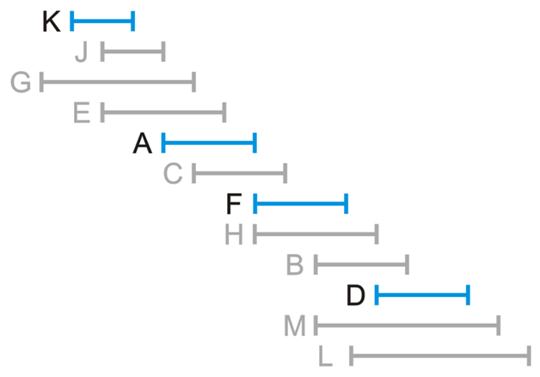
Interval scheduling: Example
The prevents us from running Process L
We are therefore finished
Process | Interval
K | 2 – 4
J | 3 – 5
G | 1 – 6
E | 3 – 7
A | 5 – 8
C | 6 – 9
F | 8 – 11
H | 8 – 12
B | 10 – 13
D | 12 – 15
M | 10 – 15
L | 11 – 16

Slide 35
Interval scheduling: analysis of earliest-finish-time-first algorithm
Theorem. The earliest-finish-time-first algorithm is optimal.
Pf. [by contradiction]
Assume greedy is not optimal, and let’s see what happens.
Let i₁, i₂, ... i_{k} denote set of jobs selected by greedy.
Let j₁, j₂, ... j_{m} denote set of jobs in an optimal solution with i₁ = j₁, i₂ = j₂, ..., i_{r} = j_{r} for the largest possible value of r.
1. job i_{r+1} exists and finishes no later than j_{r+1}
i₁
i₂
i_{r}
i_{r+1}
. . .
i_{k}
Greedy:
j₁
j₂
j_{r}
j_{r+1}
. . .
j_{m}
Optimal:
job j_{r+1} exists
because m > k
why not replace
job j_{r+1} with job i_{r+1}?
Notes:
job j_r+1 exists because m > k (by assumption, greedy is not optimal)
job i_r+1 exists because optimal schedule does same thing for first r jobs, so greedy would schedule some job next

Slide 36
Interval scheduling: analysis of earliest-finish-time-first algorithm
Theorem. The earliest-finish-time-first algorithm is optimal.
Pf. [by contradiction]
Assume greedy is not optimal, and let’s see what happens.
Let i₁, i₂, ... i_{k} denote set of jobs selected by greedy.
Let j₁, j₂, ... j_{m} denote set of jobs in an optimal solution with i₁ = j₁, i₂ = j₂, ..., i_{r} = j_{r} for the largest possible value of r.
2. job i_{k} finishes no later than j_{k}, but m > k, the greedy algorithm should not stop, as job j_{k+1} can be chosen
i₁
i₂
i_{r}
i_{r+1}
. . .
i_{k}
Greedy:
j₁
j₂
j_{r}
j_{r+1}
. . .
j_{m}
Optimal:
Notes:
job j_r+1 exists because m > k (by assumption, greedy is not optimal)
job i_k+1 exists because optimal schedule does same thing for first k jobs, so greedy would schedule some job next

Slide 37
Outline
Coin changing
Interval scheduling
Interval partitioning
Scheduling to minimize lateness
Optimal caching

Slide 38
Interval partitioning
Lecture j starts at s_{j} and finishes at f_{j}.
Goal: find minimum number of classrooms to schedule all lectures so that no two lectures occur at the same time in the same room.
Ex. This schedule uses 4 classrooms to schedule 10 lectures.
jobs e and g
are incompatible
4
e
j
3
c
d
g
2
b
h
1
a
f
i
9
9:30
10
10:30
11
11:30
12
12:30
1
1:30
2
2:30
3
3:30
4
4:30
time
Notes:
another way to think about this problem is that you want to color the intervals in such a way that no two overlapping intervals have the same color. Use as few colors as possible.
(interval graph = (u, v) is an edge iff intervals u and v overlap.)

Slide 39
Interval partitioning
Lecture j starts at s_{j} and finishes at f_{j}.
Goal: find minimum number of classrooms to schedule all lectures so that no two lectures occur at the same time in the same room.
Ex. This schedule uses 3 classrooms to schedule 10 lectures.
intervals are open
(need only 3 classrooms at 2pm)
3
c
d
f
j
2
b
g
i
1
a
e
h
9
9:30
10
10:30
11
11:30
12
12:30
1
1:30
2
2:30
3
3:30
4
4:30
time

Slide 40
Interval partitioning: greedy algorithms
Greedy template. Consider lectures in some natural order. Assign each lecture to an available classroom (which one?); allocate a new classroom if none are available.
[Earliest start time] Consider lectures in ascending order of s_{j}.
[Earliest finish time] Consider lectures in ascending order of f_{j}.
[Shortest interval] Consider lectures in ascending order of f_{j} – s_{j}.
[Fewest conflicts] For each lecture j, count the number of conflicting lectures c_{j}. Schedule in ascending order of c_{j}.

Slide 41
Interval partitioning: greedy algorithms
Greedy template. Consider lectures in some natural order. Assign each lecture to an available classroom (which one?); allocate a new classroom if none are available.
counterexample for earliest finish time
3
2
1
counterexample for shortest interval
3
2
1
counterexample for fewest conflicts
3
2
1
Notes:
[wayne s18] could use better counterexamples where *every* execution of algorithms yields suboptimal solution
in earliest finish time, the short interval could be assigned to classroom 2 or 3; if 2, then it requires a 3rd classroom
in shortest interval, the 3rd smallest job could be assigned to classroom 1 or 2; if 1 then it requires a 3rd classroom

Slide 42
Interval partitioning: earliest-start-time-first algorithm
Earliest-Start-Time-First (n, s1, s2, …, sn , f1, f2, …, fn)
_________________________________________________________________________________________________________________________________________________________________________________________________________________________________________________________________________________________________________________________________________________________________________________________________________________________________________________________________________________________________________________________________________________________________________________________________________________________________________________________________________________________________________________________________________________________________________________________________________________________________________________________________________________________________________________________________________________________________________________________________________________________________________________________________________________________________________________________________________________________
Sort lectures by start times and renumber so that s1 ≤ s2 ≤ … ≤ sn.
d ← 0.
For j = 1 to n
If (lecture j is compatible with some classroom)
Schedule lecture j in any such classroom k.
Else
Allocate a new classroom d + 1.
Schedule lecture j in classroom d + 1.
d ← d + 1.
Return schedule.
_________________________________________________________________________________________________________________________________________________________________________________________________________________________________________________________________________________________________________________________________________________________________________________________________________________________________________________________________________________________________________________________________________________________________________________________________________________________________________________________________________________________________________________________________________________________________________________________________________________________________________________________________________________________________________________________________________________________________________________________________________________________________________________________________________________________________________________________________________________________
number of allocated classrooms

Slide 43
Interval partitioning: Example
4
3
2
1
a
b
c
d
e
f
g
h
i
j
Notes:
another way to think about this problem is that you want to color the intervals in such a way that no two overlapping intervals have the same color. Use as few colors as possible.
(interval graph = (u, v) is an edge iff intervals u and v overlap.)

Slide 44
Interval partitioning: Example
4
3
2
1
a
b
c
d
e
f
g
h
i
j
Notes:
another way to think about this problem is that you want to color the intervals in such a way that no two overlapping intervals have the same color. Use as few colors as possible.
(interval graph = (u, v) is an edge iff intervals u and v overlap.)

Slide 45
Interval partitioning: Example
4
3
2
b
1
a
c
d
e
f
g
h
i
j
Notes:
another way to think about this problem is that you want to color the intervals in such a way that no two overlapping intervals have the same color. Use as few colors as possible.
(interval graph = (u, v) is an edge iff intervals u and v overlap.)

Slide 46
Interval partitioning: Example
4
3
c
2
b
1
a
d
e
f
g
h
i
j
Notes:
another way to think about this problem is that you want to color the intervals in such a way that no two overlapping intervals have the same color. Use as few colors as possible.
(interval graph = (u, v) is an edge iff intervals u and v overlap.)

Slide 47
Interval partitioning: Example
4
3
c
2
b
1
a
d
e
f
g
h
i
j
Notes:
another way to think about this problem is that you want to color the intervals in such a way that no two overlapping intervals have the same color. Use as few colors as possible.
(interval graph = (u, v) is an edge iff intervals u and v overlap.)

Slide 48
Interval partitioning: Example
4
3
c
e
2
b
1
a
d
f
g
h
i
j
Notes:
another way to think about this problem is that you want to color the intervals in such a way that no two overlapping intervals have the same color. Use as few colors as possible.
(interval graph = (u, v) is an edge iff intervals u and v overlap.)

Slide 49
Interval partitioning: Example
4
3
c
e
2
b
1
a
d
f
g
h
i
j
Notes:
another way to think about this problem is that you want to color the intervals in such a way that no two overlapping intervals have the same color. Use as few colors as possible.
(interval graph = (u, v) is an edge iff intervals u and v overlap.)

Slide 50
Interval partitioning: Example
4
3
c
e
2
b
g
1
a
d
f
h
i
j
Notes:
another way to think about this problem is that you want to color the intervals in such a way that no two overlapping intervals have the same color. Use as few colors as possible.
(interval graph = (u, v) is an edge iff intervals u and v overlap.)

Slide 51
Interval partitioning: Example
4
3
c
e
h
2
b
g
1
a
d
f
i
j
Notes:
another way to think about this problem is that you want to color the intervals in such a way that no two overlapping intervals have the same color. Use as few colors as possible.
(interval graph = (u, v) is an edge iff intervals u and v overlap.)

Slide 52
Interval partitioning: Example
4
3
c
e
h
2
b
g
j
1
a
d
f
i
Notes:
another way to think about this problem is that you want to color the intervals in such a way that no two overlapping intervals have the same color. Use as few colors as possible.
(interval graph = (u, v) is an edge iff intervals u and v overlap.)

Slide 53
Interval partitioning: earliest-start-time-first algorithm
Proposition. The earliest-start-time-first algorithm can be implemented in O(n log n) time.
Pf. Store classrooms in a priority queue (key = finish time of its last lecture).
To determine whether lecture j is compatible with some classroom, compare sj to key of min classroom k in priority queue.
To add lecture j to classroom k, increase key of classroom k to fj.
Total number of priority queue operations is O(n).
Sorting by start times takes O(n log n) time. ▪
Remark. This implementation chooses a classroom k whose finish time of its last lecture is the earliest.
Notes:
Remark. Even though we are assignment to a specific classroom (finish time of last lecture is earliest), the proof of correctness of algorithm applies as long as we assign it to any compatible classroom.
Challenge. Efficient implementation that choose the classroom k whose finish time of its last lecture is the latest among those whose finish time ≤ sj.
Solution: use a BST. Key operation needed is ceiling.

Slide 54
Interval partitioning: lower bound on optimal solution
Def. The depth of a set of open intervals is the maximum number of intervals that contain any given point.
Key observation. Number of classrooms needed ≥ depth.
a
b
c
3
d
e
f
3
g
1
h
i
depth = 3
3
j
Notes:
open interval = don’t include left or right endpoint
this provides one reason why we need at least d classrooms. Are there any other reasons? No!
(in terms of interval graph terminology, the chromatic number = max clique size)

Slide 55
Interval partitioning: lower bound on optimal solution
Def. The depth of a set of open intervals is the maximum number of intervals that contain any given point.
Key observation. Number of classrooms needed ≥ depth.
Q. Does minimum number of classrooms needed always equal depth?
A. Yes! Moreover, earliest-start-time-first algorithm finds a schedule whose number of classrooms equals the depth.
depth = 3
3
c
d
f
j
2
b
g
i
1
a
e
h
9
9:30
10
10:30
11
11:30
12
12:30
1
1:30
2
2:30
3
3:30
4
4:30
time
Notes:
open interval = don’t include left or right endpoint
this provides one reason why we need at least d classrooms. Are there any other reasons? No!
(in terms of interval graph terminology, the chromatic number = max clique size)

Slide 56
Interval partitioning: analysis of earliest-start-time-first algorithm
Observation. The earliest-start-time first algorithm never schedules two incompatible lectures in the same classroom.
Theorem. Earliest-start-time-first algorithm is optimal.
Pf.
Let d = number of classrooms that the algorithm allocates.
Classroom d is opened because we needed to schedule a lecture, say j, that is incompatible with a lecture in each of d – 1 other classrooms.
Thus, these d-1 lectures each end after s_{j}.
Since we sorted by start time, each of these incompatible lectures start no later than s_{j}.
Thus, we have d lectures overlapping at time s_{j} + ε.
Key observation ⇒ all schedules use ≥ d classrooms. ▪

Slide 57
Outline
Coin changing
Interval scheduling
Interval partitioning
Scheduling to minimize lateness
Optimal caching

Slide 58
Scheduling to minimizing lateness
Single resource processes one job at a time.
Job j requires t_{j} units of processing time and is due at time d_{j}.
If j starts at time s_{j}, it finishes at time f_{j} = s_{j} + t_{j}.
Lateness: ℓ _{j} = max { 0, f_{j} – d_{j} }.
Goal: schedule all jobs to minimize maximum lateness L = max_{j} ℓ_{j}.
1
2
3
4
5
6
t_{j}
3
2
1
4
3
2
d_{j}
6
8
9
9
14
15
lateness = 2
lateness = 0
max lateness = 6
Shortest processing time first
d₃ = 9
d₂ = 8
d₆ = 15
d₁ = 6
d₅ = 14
d₄ = 9
0
1
2
3
4
5
6
7
8
9
10
11
12
13
14
15
Notes:
Note: finding a maximal size subset of jobs that meet deadline is NP-hard.

Slide 59
Minimizing lateness: greedy algorithms
Greedy template. Schedule jobs according to some natural order.
[Shortest processing time first] Schedule jobs in ascending order of processing time t_{j}.
[Earliest deadline first] Schedule jobs in ascending order of deadline d_{j}.
[Smallest slack] Schedule jobs in ascending order of slack d_{j} – t_{j}.

Slide 60
Minimizing lateness: greedy algorithms
Greedy template. Schedule jobs according to some natural order.
[Shortest processing time first] Schedule jobs in ascending order of processing time t_{j}.
[Smallest slack] Schedule jobs in ascending order of slack d_{j} – t_{j}.
 | 1 | 2
tj | 1 | 10
dj | 100 | 10
counterexample
 | 1 | 2
tj | 1 | 10
dj | 2 | 10
counterexample

Slide 61
Minimizing lateness: earliest deadline first
Earliest-Deadline-First (n, t1, t2, …, tn , d1, d2, …, dn)
__________________________________________________________________________________________________________________________________________________________________________________________________________________________________________________________________________________________________________________________________________________________________________________________________________________________________________________________________________________________________________________________________________________________________________________________________________________________________________________________________________________________________________________________________________________________________________________________________________________________________________________________________________________________________________________________________________________________________________________________________________________________________________________________________________________________________________________________________________
Sort jobs by due times and renumber so that d1 ≤ d2 ≤ … ≤ dn.
t ← 0.
For j = 1 to n
Assign job j to interval [t, t + tj ].
sj ← t ; fj ← t + tj.
t ← t + tj.
Return intervals [s1, f1], [s2, f2], …, [sn, fn].
__________________________________________________________________________________________________________________________________________________________________________________________________________________________________________________________________________________________________________________________________________________________________________________________________________________________________________________________________________________________________________________________________________________________________________________________________________________________________________________________________________________________________________________________________________________________________________________________________________________________________________________________________________________________________________________________________________________________________________________________________________________________________________________________________________________________________________________________________________
1
2
3
4
5
6
t_{j}
3
2
1
4
3
2
d_{j}
6
8
9
9
14
15
max lateness L = 1
Earliest deadline time first
d₁ = 6
d₂ = 8
d₃ = 9
d₄ = 9
d₅ = 14
d₆ = 15
0
1
2
3
4
5
6
7
8
9
10
11
12
13
14
15

Slide 62
Minimizing lateness: no idle time
Observation 1. There exists an optimal schedule with no idle time.
Observation 2. The earliest-deadline-first schedule has no idle time.
an optimal schedule
d = 4
d = 6
d = 12
0
1
2
3
4
5
6
7
8
9
10
11
an optimal schedule
with no idle time
d = 4
d = 6
d = 12
0
1
2
3
4
5
6
7
8
9
10
11
Notes:
“machine not working for some reason, yet work still to be done"

Slide 63

Minimizing lateness: inversions
Def. Given a schedule S, an inversion is a pair of jobs i and j such that: $d_{i}$ $≤$ $d_{j}$ but j is scheduled before i.
Observation 3. The earliest-deadline-first schedule is the unique idle-free schedule with no inversions.
inversion if i < j
a schedule with
an inversion
j
i
recall: we assume the jobs are numbered so that d1 ≤ d2 ≤ … ≤ dn
1 | 2 | 3 | 4 | 5 | 6 | … | n
Notes:
Recall: jobs sorted in ascending order of due dates
[wayne s18] our definition of inversion is slightly stronger than K-T. We still consider i-j an inversion even if di = dj, as long as i < j and j scheduled before i.

Slide 64
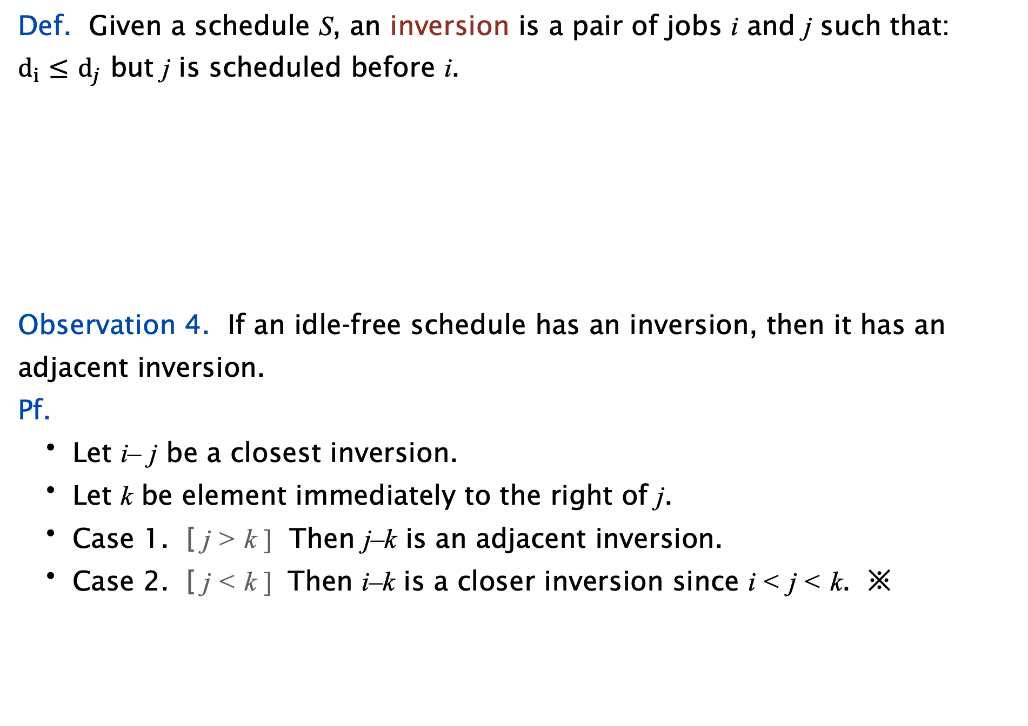
Minimizing lateness: inversions
Def. Given a schedule S, an inversion is a pair of jobs i and j such that: $d_{i}$ $≤$ $d_{j}$ but j is scheduled before i.
Observation 4. If an idle-free schedule has an inversion, then it has an adjacent inversion.
Pf.
Let i– j be a closest inversion.
Let k be element immediately to the right of j.
Case 1. [ j > k ] Then j–k is an adjacent inversion.
Case 2. [ j < k ] Then i–k is a closer inversion since i < j < k. ※
inversion if i < j
a schedule with
an inversion
j
i
recall: we assume the jobs are numbered so that d1 ≤ d2 ≤ … ≤ dn
two inverted jobs scheduled consecutively
 | j |  |  |  | i
k
Notes:
k can equal i (if so, i-j would be adjacent inversion and we would be in case 1)

Slide 65
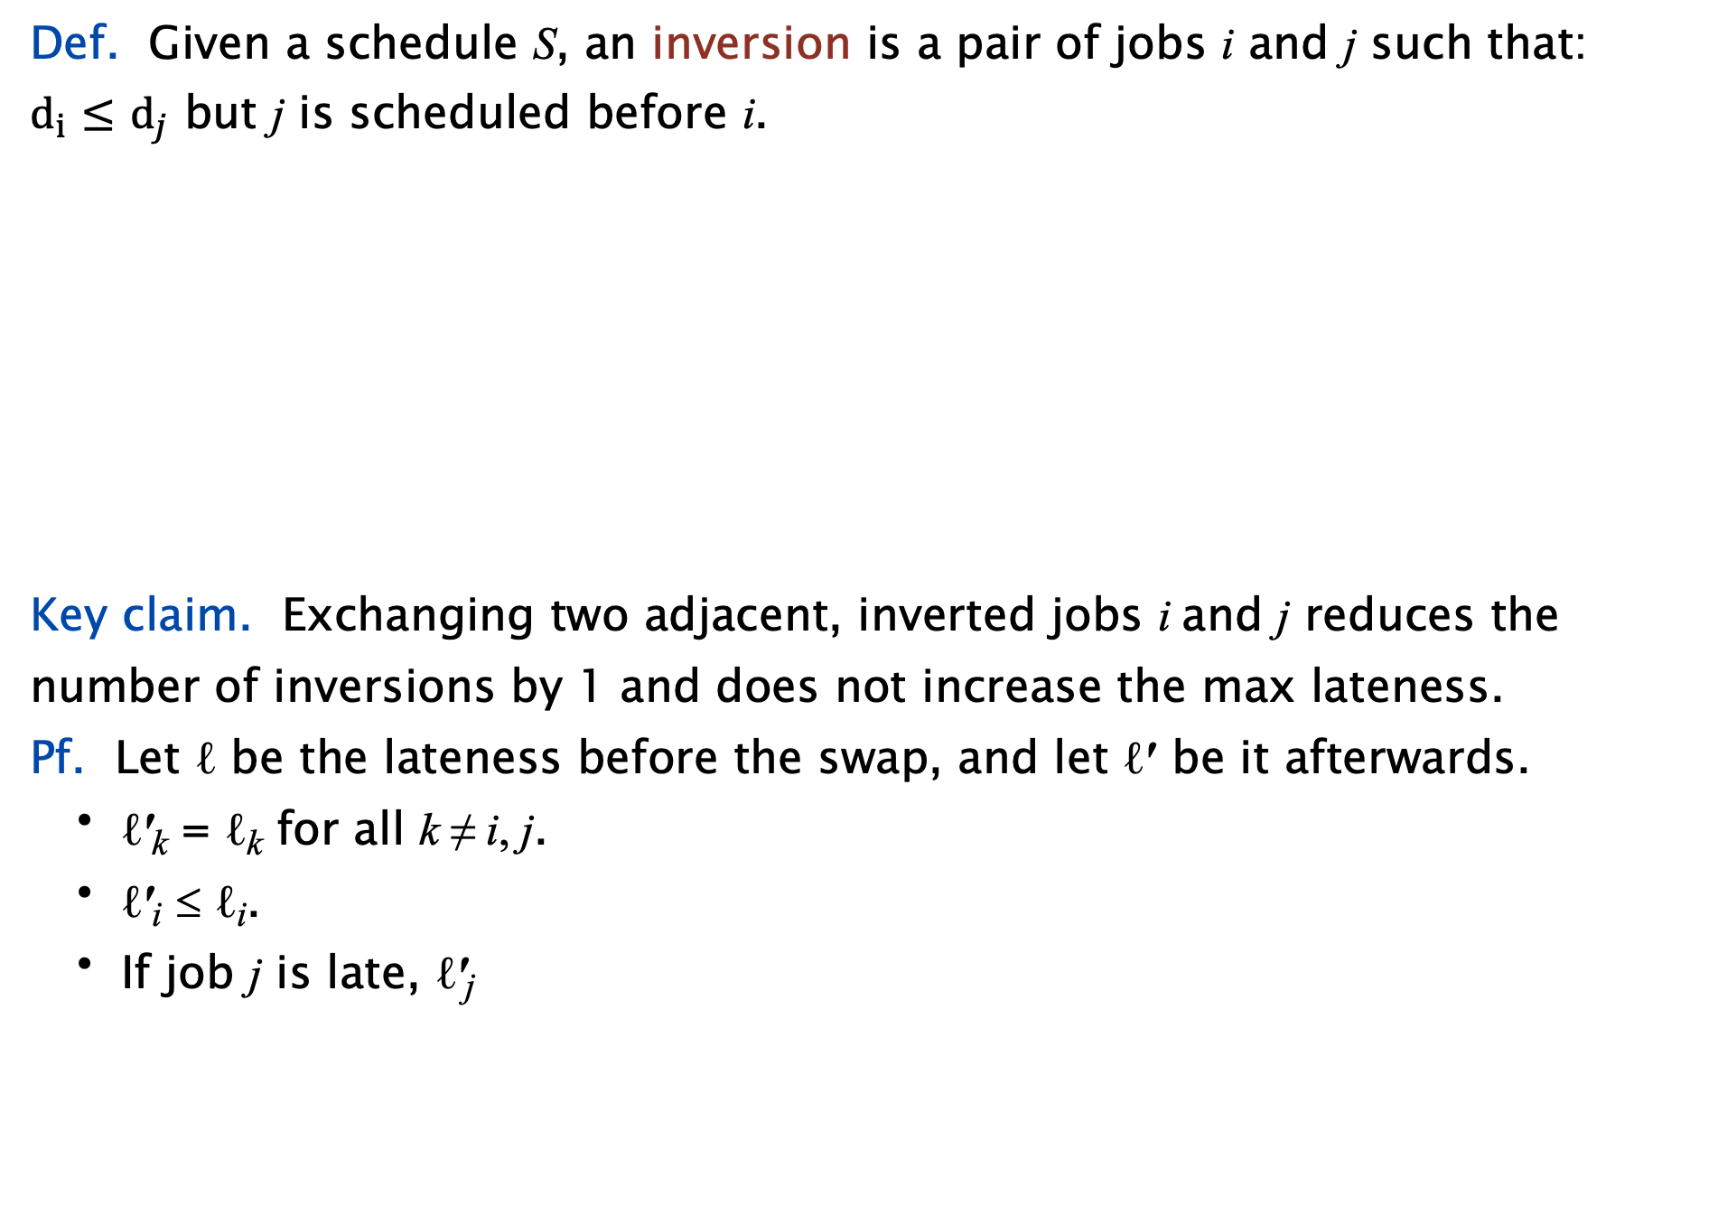
Minimizing lateness: inversions
Def. Given a schedule S, an inversion is a pair of jobs i and j such that: $d_{i}$ $≤$ $d_{j}$ but j is scheduled before i.
Key claim. Exchanging two adjacent, inverted jobs i and j reduces the number of inversions by 1 and does not increase the max lateness.
Pf. Let ℓ be the lateness before the swap, and let ℓ′ be it afterwards.
ℓ′_{k} = ℓ_{k} for all k ≠ i, j.
ℓ′_{i} ≤ ℓ _{i}.
If job j is late, ℓ′ _{j}
inversion if i < j
f_{i}
before
exchange
j
i
after
exchange
i
j
f′_{j}
= f′j – dj
= fi – dj
≤ fi – di
≤ ℓ_{i} .
definition
j now finishes at time fi
i < j ⇒ di ≤ dj
definition
Notes:
fi - di <= max {0, fi - di} = li

Slide 66









Minimizing lateness: inversions
Def. Given a schedule S, an inversion is a pair of jobs i and j such that: $d_{i}$ $≤$ $d_{j}$ but j is scheduled before i.
Key claim. Exchanging two adjacent, inverted jobs i and j reduces the number of inversions by 1 and does not increase the max lateness.
Pf. Let ℓ be the lateness before the swap, and let ℓ′ be it afterwards.
ℓ′_{k} = ℓ_{k} for all k ≠ i, j.
ℓ′_{i} ≤ ℓ _{i}.
If job j is late, ℓ′ _{j}
$$d_{i}$$
$$d_{j}$$
${(d}_{i}$ $≤$ $d_{j}$ )
$\text{L}\text{ = }\text{max}\text{j} \text{ℓ}\text{j}$= $max\left({\text{ℓ}}_{j}\text{,}\text{ℓ}\text{i}\right)={\text{ℓ}}_{i}$
${\text{ℓ}}_{j}$ $=$ $f_{j}$ - $d_{j}$
${\text{ℓ}}_{i}$ $=$ $f_{i}$ - $d_{i}$
f_{i}
before
exchange
j
i
after
exchange
i
j
${\text{ℓ}’}_{j}$ $=$ ${f′}_{j}$ - $d_{j}$
f′_{j}
${\text{ℓ}’}_{i}$ $=$ ${f′}_{i}$ - $d_{i}$
$\text{L}’\text{ = }\text{max}\text{j} \text{ℓ}\text{j}$=$max\left({\text{ℓ}’}_{j}\text{,}\text{ℓ}’\text{i}\right)=\text{ℓ}’\text{j}$
= f′j – dj
= fi – dj
≤ fi – di
≤ ℓ_{i} .
definition
j now finishes at time fi
i < j ⇒ di ≤ dj
definition
Notes:
fi - di <= max {0, fi - di} = li

Slide 67
Minimizing lateness: inversions
Def. Given a schedule S, an inversion is a pair of jobs i and j such that: $d_{i}$ $≤$ $d_{j}$ but j is scheduled before i.
Key claim. Exchanging two adjacent, inverted jobs i and j reduces the number of inversions by 1 and does not increase the max lateness.
Pf. Let ℓ be the lateness before the swap, and let ℓ′ be it afterwards.
ℓ′_{k} = ℓ_{k} for all k ≠ i, j.
ℓ′_{i} ≤ ℓ _{i}.
If job j is late, ℓ′ _{j}
$$d_{i}$$
$$d_{j}$$
${(d}_{i}$ $≤$ $d_{j}$ )
$\text{L}\text{ = }\text{max}\text{j} \text{ℓ}\text{j}$= $max\left({\text{ℓ}}_{j}\text{,}\text{ℓ}\text{i}\right)={\text{ℓ}}_{i}$
${\text{ℓ}}_{j}$ $=$ $f_{j}$ - $d_{j}$
${\text{ℓ}}_{i}$ $=$ $f_{i}$ - $d_{i}$
f_{i}
before
exchange
j
i
after
exchange
i
j
${\text{ℓ}’}_{j}$ $=$ ${f′}_{j}$ - $d_{j}$
f′_{j}
${\text{ℓ}’}_{i}$ $=$ ${f′}_{i}$ - $d_{i}$
$\text{L}’\text{ = }\text{max}\text{j} \text{ℓ}\text{j}$=$max\left({\text{ℓ}’}_{j}\text{,}\text{ℓ}’\text{i}\right)=\text{ℓ}’\text{j}$
= f′j – dj
= fi – dj
≤ fi – di
≤ ℓ_{i} .
definition
j now finishes at time fi
i < j ⇒ di ≤ dj
definition
Notes:
fi - di <= max {0, fi - di} = li

Slide 68
Minimizing lateness: inversions
Def. Given a schedule S, an inversion is a pair of jobs i and j such that: $d_{i}$ $≤$ $d_{j}$ but j is scheduled before i.
Key claim. Exchanging two adjacent, inverted jobs i and j reduces the number of inversions by 1 and does not increase the max lateness.
Pf. Let ℓ be the lateness before the swap, and let ℓ′ be it afterwards.
ℓ′_{k} = ℓ_{k} for all k ≠ i, j.
ℓ′_{i} ≤ ℓ _{i}.
If job j is late, ℓ′ _{j}
$$d_{i}$$
$$d_{j}$$
${(d}_{i}$ $≤$ $d_{j}$ )
$\text{L}\text{ = }\text{max}\text{j} \text{ℓ}\text{j}$= $max\left({\text{ℓ}}_{j}\text{,}\text{ℓ}\text{i}\right)={\text{ℓ}}_{i}$
${\text{ℓ}}_{j}$ $=$ $f_{j}$ - $d_{j}$
${\text{ℓ}}_{i}$ $=$ $f_{i}$ - $d_{i}$
f_{i}
before
exchange
j
i
after
exchange
i
j
${\text{ℓ}’}_{j}$ $=$ ${f′}_{j}$ - $d_{j}$
f′_{j}
${\text{ℓ}’}_{i}$ $=$ ${f′}_{i}$ - $d_{i}$
$\text{L}’\text{ = }\text{max}\text{j} \text{ℓ}\text{j}$=$max\left({\text{ℓ}’}_{j}\text{,}\text{ℓ}’\text{i}\right)=\text{ℓ}’\text{j}$
= f′j – dj
= fi – dj
≤ fi – di
≤ ℓ_{i} .
definition
j now finishes at time fi
i < j ⇒ di ≤ dj
definition
Notes:
fi - di <= max {0, fi - di} = li

Slide 69
Minimizing lateness: analysis of earliest-deadline-first algorithm
Theorem. The earliest-deadline-first schedule S is optimal.
Pf. [by contradiction]
Define S* to be an optimal schedule with the fewest inversions.
Can assume S* has no idle time.
Case 1. [ S* has no inversions ] Then S = S*.
Case 2. [ S* has an inversion ]
let i–j be an adjacent inversion
exchanging jobs i and j decreases the number of inversions by 1 without increasing the max lateness
contradicts “fewest inversions” part of the definition of S* ※
optimal schedule can
have inversions
Observation 1
Observation 3
Observation 4
key claim
Notes:
optimal schedule can have inversions, either because two jobs have same due times or because there is slack in schedule (and non-late jobs can be permuted)

Slide 70
Greedy analysis strategies
Greedy algorithm stays ahead. Show that after each step of the greedy algorithm, its solution is at least as good as any other algorithm’s.
Structural. Discover a simple “structural” bound asserting that every possible solution must have a certain value. Then show that your algorithm always achieves this bound.
Exchange argument. Gradually transform any solution to the one found by the greedy algorithm without hurting its quality.
Other greedy algorithms. Kruskal, Dijkstra, Huffman, …
Notes:
Hard, if not impossible, to precisely define "greedy algorithm." Though there are some formalizations, e.g., matroids.
myopic
greedy: "at every iteration, the algorithm chooses the best morsel it can swallow, without worrying about the future"
Objective function. Does not explicitly appear in greedy algorithm!

Slide 71
Outline
Coin changing
Interval scheduling
Interval partitioning
Scheduling to minimize lateness
Optimal caching
Notes:
Abstract Data Type Sorted List

Slide 72
Optimal offline caching
Caching.
Cache with capacity to store k items.
Sequence of m item requests d₁, d₂, …, d_{m}.
Cache hit: item in cache when requested.
Cache miss: item not in cache when requested. (must evict some item from cache and bring requested item into cache)
Applications. CPU, RAM, hard drive, web, browser, ….
Goal. Eviction schedule that minimizes the number of evictions.
Ex. k = 2, initial cache = ab, requests: a, b, c, b, c, a, b.
Optimal eviction schedule. 2 evictions.
cache
cache miss
(eviction)
a | a | b
b | a | b
c | c | b
b | c | b
c | c | b
a | a | b
b | a | b
requests
Notes:
There is a small amount of data that can be accessed very quickly, and a large amount of data that requires more time to access. You must decide which pieces of data to have close at hand.
[wayne s18] emphasize that we are solving offline version of problem
# evictions may not equal # cache misses in unreduced schedule
we’ll assume cache always has k items

Slide 73
Optimal offline caching: farthest-in-future (clairvoyant algorithm)
Farthest-in-future. Evict item in the cache that is not requested until farthest in the future.
cache
a | a | b | c | d | e
f | ? | ? | ? | ? | ?
a
b
c
e
g
b
e
d
⋮
cache miss
(which item to eject?)
requests
FF: eject d

Slide 74
Reduced eviction schedules
Def. A reduced schedule is a schedule that brings an item d into the cache in step j only if there is a request for d in step j and d is not already in the cache.
a | a | b | c
a | a | b | c
c | a | d | c
d | a | d | c
a | a | c | b
b | a | c | b
c | a | c | b
d | d | c | b
d | d | c | d
a | a | b | c
a | a | b | c
c | a | b | c
d | a | d | c
a | a | d | c
b | a | d | b
c | a | c | b
d | d | c | b
d | d | c | b
d enters cache
without a request
d enters cache
even though already
in cache
an unreduced schedule
a reduced schedule
Notes:
schedule can do some crazy stuff (e.g., evict item when it is requested or insert multiple items in a step in which they are not requested)

Slide 75
Reduced eviction schedules
Claim. Given any unreduced schedule S, can transform it into a reduced schedule S′ with no more evictions.
Pf. [ by induction on number of steps j ]
Suppose S brings d into the cache in step j without a request.
Let c be the item S evicts when it brings d into the cache.
Case 1a: d evicted before next request for d.
unreduced schedule S
S′
 | . | . | c
 | . | . | c
 | . | . | c
¬d | . | . | d
¬d | . | . | d
¬d | . | . | d
e | . | . | e
 | . | . | e
 | . | . | c
 | . | . | c
 | . | . | c
¬d | . | . | c
¬d | . | . | c
¬d | . | . | c
e | . | . | e
 | . | . | e
step j
d enters cache without a request
might as well
leave c in cache
until d is evicted
step j′
d evicted before
next request for d

Slide 76
Reduced eviction schedules
Claim. Given any unreduced schedule S, can transform it into a reduced schedule S′ with no more evictions.
Pf. [ by induction on number of steps j ]
Suppose S brings d into the cache in step j without a request.
Let c be the item S evicts when it brings d into the cache.
Case 1a: d evicted before next request for d.
Case 1b: next request for d occurs before d is evicted.
unreduced schedule S
S′
 | . | . | c
 | . | . | c
 | . | . | c
¬d | . | . | d
¬d | . | . | d
¬d | . | . | d
d | . | . | d
 | . | . | d
 | . | . | c
 | . | . | c
 | . | . | c
¬d | . | . | c
¬d | . | . | c
¬d | . | . | c
d | . | . | d
 | . | . | d
step j
d enters cache without a request
might as well
leave c in cache
until d is requested
step j′
d still in cache before
next request for d
Notes:
j’ is first time d is requested after step j

Slide 77
Reduced eviction schedules
Claim. Given any unreduced schedule S, can transform it into a reduced schedule S′ with no more evictions.
Pf. [ by induction on number of steps j ]
Suppose S brings d into the cache in step j even though d is in cache.
Let c be the item S evicts when it brings d into the cache.
Case 2a: d evicted before it is needed.
unreduced schedule S
S′
 | d1 | a | c
 | d1 | a | c
 | d1 | a | c
d | d1 | a | d3
d | d1 | a | d3
c | c | a | d3
b | c | a | b
d | c | a | d3
 | d1 | a | c
 | d1 | a | c
 | d1 | a | c
d | d1 | a | c
d | d1 | a | c
c | c | a | c
b | c | a | b
d | c | a | d3
d3 enters cache even though d1 is
already in cache
might as well
leave c in cache
until d3 in evicted
step j
d3 not needed
step j′
d3 evicted
d3 needed

Slide 78
Reduced eviction schedules
Claim. Given any unreduced schedule S, can transform it into a reduced schedule S′ with no more evictions.
Pf. [ by induction on number of steps j ]
Suppose S brings d into the cache in step j even though d is in cache.
Let c be the item S evicts when it brings d into the cache.
Case 2a: d evicted before it is needed.
Case 2b: d needed before it is evicted.
unreduced schedule S
S′
 | d1 | a | c
 | d1 | a | c
 | d1 | a | c
d | d1 | a | d3
d | d1 | a | d3
c | c | a | d3
a | c | a | d3
d | c | a | d3
 | d1 | a | c
 | d1 | a | c
 | d1 | a | c
d | d1 | a | c
d | d1 | a | c
c | c | a | c
a | c | a | c
d | c | a | d3
d3 enters cache even though d1 is
already in cache
step j
might as well
leave c in cache
until d3 in needed
d3 not needed
step j′
d3 needed
Notes:
Note: c is now in the cache twice.

Slide 79
Reduced eviction schedules
Claim. Given any unreduced schedule S, can transform it into a reduced schedule S′ with no more evictions.
Pf. [ by induction on number of steps j ]
Case 1: S brings d into the cache in step j without a request. ✔
Case 2: S brings d into the cache in step j even though d is in cache. ✔
If multiple unreduced items in step j, apply each one in turn, dealing with Case 1 before Case 2. ▪
resolving Case 1 might trigger Case 2

Slide 80
Farthest-in-future: analysis
Theorem. FF is optimal eviction algorithm.
Pf. Follows directly from the following invariant.
Invariant. There exists an optimal reduced schedule S that has the same eviction schedule as S_{FF} through the first j steps. Pf. [ by induction on number of steps j ]
Base case: j = 0.
Let S be reduced schedule that satisfies invariant through j steps. We produce S′ that satisfies invariant after j + 1 steps.
Let d denote the item requested in step j + 1.
Since S and S_{FF} have agreed up until now, they have the same cache contents before step j + 1.
Case 1: d is already in the cache. S′ = S satisfies invariant.
Case 2: d is not in the cache and S and S_{FF} evict the same item. S′ = S satisfies invariant.

Slide 81
Farthest-in-future: analysis
Pf. [continued]
Case 3: d is not in the cache; S_{FF} evicts e; S evicts f ≠ e.
begin construction of S′ from S by evicting e instead of f
now S′ agrees with S_{FF} for first j + 1 steps; we show that having item f in cache is no worse than having item e in cache
let S′ behave the same as S until S′ is forced to take a different action (because either S evicts e; or because either e or f is requested)
same | e | f
step j
same | e | f
S
S′
same | e | d
step j+1
same | d | f

Slide 82
Farthest-in-future: analysis
Let j′ be the first step after j + 1 that S′ must take a different action from S; let g denote the item requested in step j′.
Case 3a: g = e.
Can’t happen with FF since there must be a request for f before e.
Case 3b: g = f.
Element f can’t be in cache of S; let e′ be the item that S evicts.
if e′ = e, S′ accesses f from cache; now S and S′ have same cache
if e′ ≠ e, we make S′ evict e′ and bring e into the cache; now S and S′ have the same cache
We let S′ behave exactly like S for remaining requests.
involves either e or f (or both)
same | e
step j′
same | f
S
S′
S′ agrees with SFF through first j + 1 steps
S′ is no longer reduced, but can be transformed into a reduced schedule that agrees with FF through first j + 1 steps
Notes:
Case 3a is the only place in the proof where we use the farthest-in-future rule.

Slide 83
Farthest-in-future: analysis
Let j′ be the first step after j + 1 that S′ must take a different action from S; let g denote the item requested in step j′.
Case 3c: g ≠ e, f. S evicts e.
make S′ evict f .
now S and S′ have the same cache
let S′ behave exactly like S for the remaining requests ▪
involves wither e or f (or both)
same | e
step j′
same | f
S
S′
otherwise S′ could have taken the same action
same | g
step j′
same | g
S
S′

